Slide 1

Predicting a Movie's Success
Briana Liu
Kanwal Iftikhar
Stephanie Gutierrez
Zach Blackburn

Slide 2
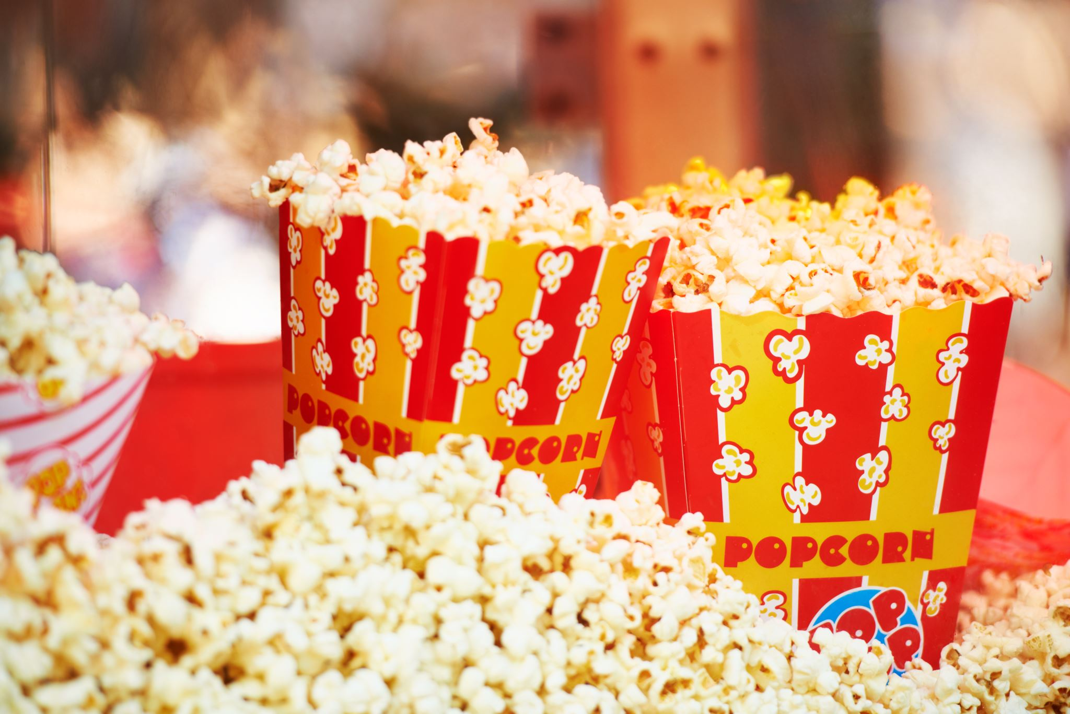
Overview:
Movies wield significant influence in modern culture, molding the realms of entertainment and lifestyle.
Individuals frequently allocate their leisure hours to indulging in movies or organizing trips to cinemas.
Despite high anticipation, many movies can disappoint in terms of content, leading to a sense of wasted time and money.

Slide 3

Goal
Be able to predict whether a movie will be successful depending on its:
Budget,
Runtime,
Genre

Slide 4
Dataset
The Kaggle dataset uses information from TMDB. This dataset contains two data sources: tmdb_5000_credits and tmdb_5000_movies.
tmdb_5000_credits features:
movie_id, title, cast, crew
tmdb_5000_movies features:
budget, genres, homepage, id, keywords, original_language, original_title, overview, popularity, production_companies, production_countries, release_date, revenue, runtime, spoken_languages, status, tagline, title, vote_average, vote_count

Slide 5
Methodology
Data Acquisition
Obtain the TMDB 5000 Movie Dataset from Kaggle.
Data Preprocessing & Cleaning
Handle missing values, duplicates, and irrelevant features
Exploratory Data Analysis
Perform exploratory analysis to understand the distribution of features and their relationships.
Create visualizations to present findings and insights.
Visualization & Reporting
Train each selected model on the training data.
Model Training & Evaluation
Model Selection & Preparation
Feature Selection
Visualize key insights through graphs and plots.
Generate a correlation matrix to identify significant feature correlations.
Select relevant features to include in the predictive model.
Identify features that have a strong correlation with movie success metrics.
Choose suitable supervised learning models for prediction (Decision Tree, Random Forest, K-nearest Neighbors, SVM).

Slide 6
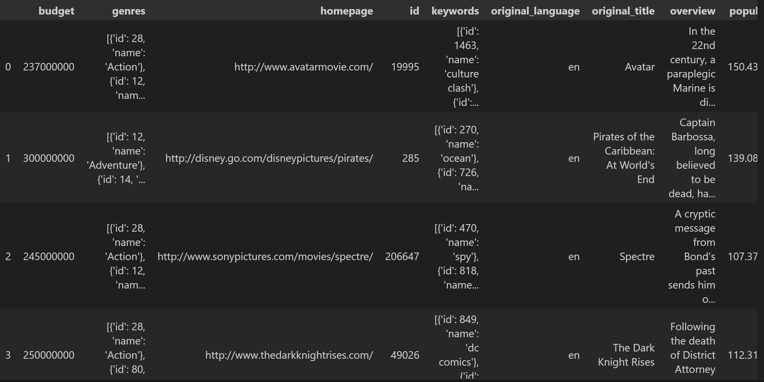
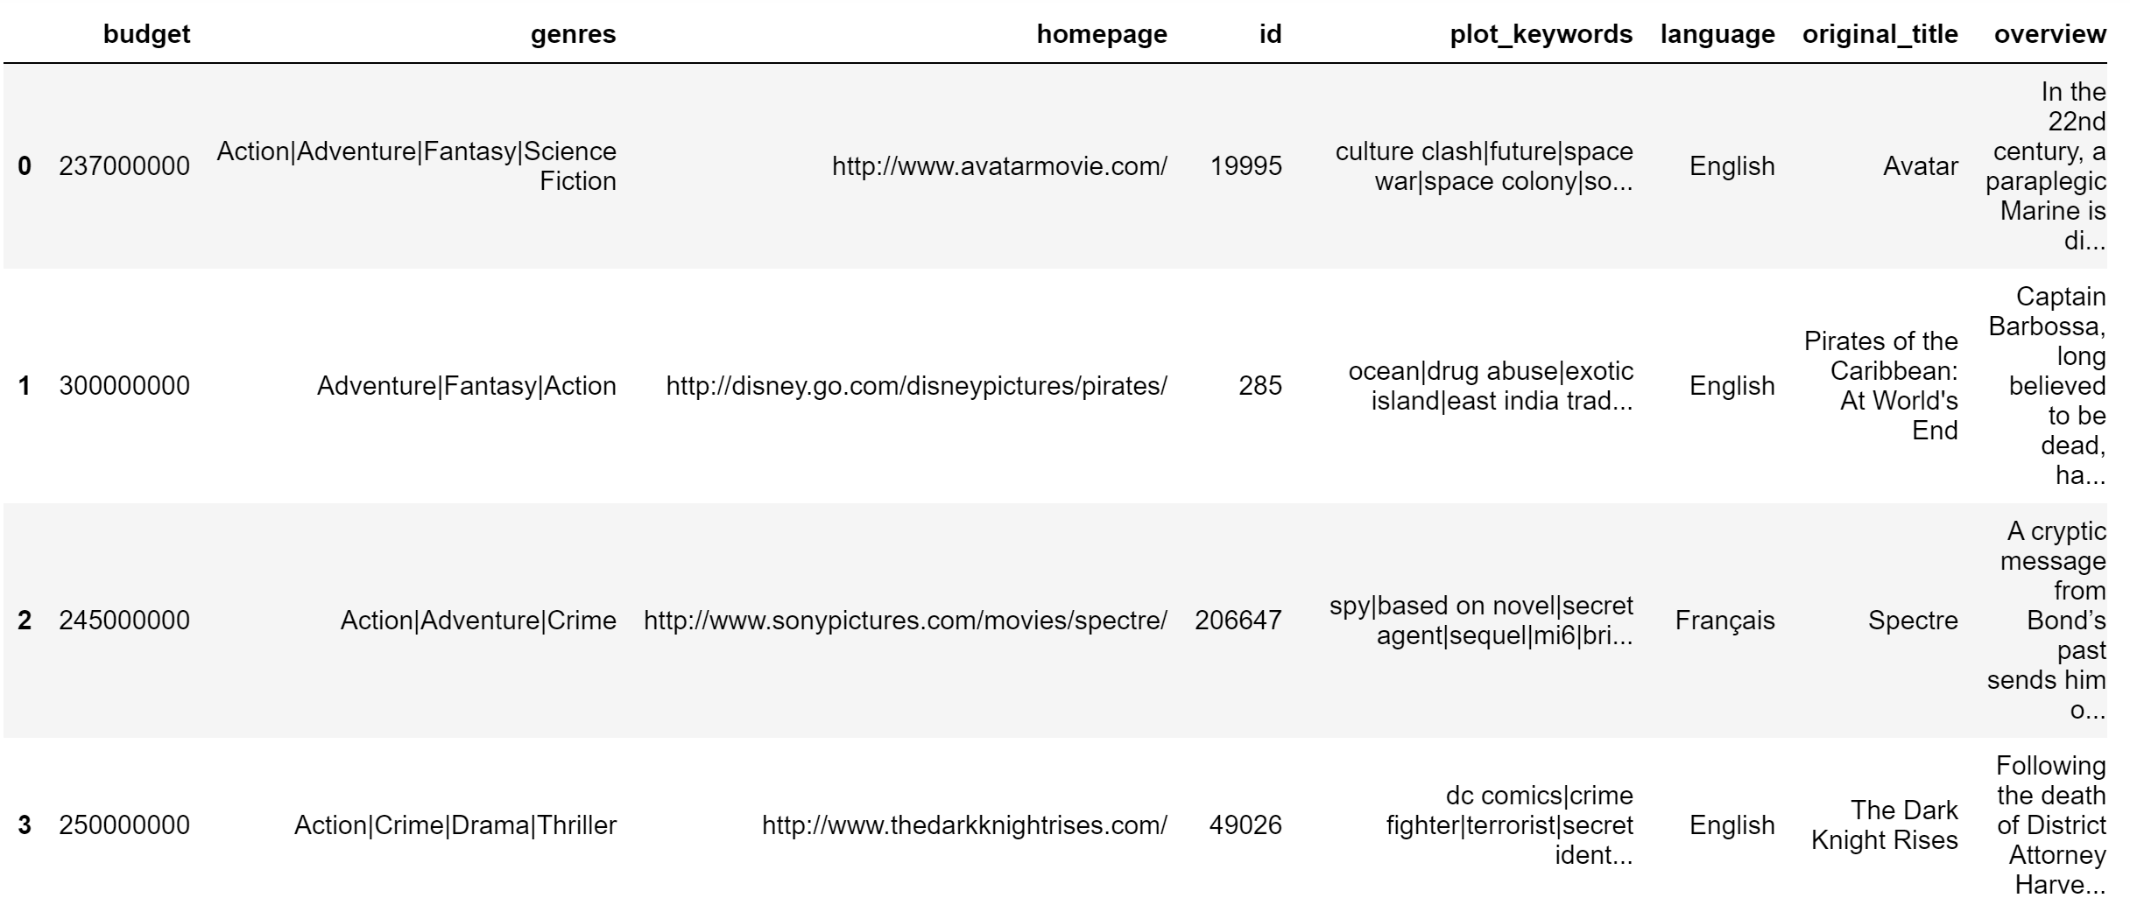
Data Preprocessing Before and After

Slide 7
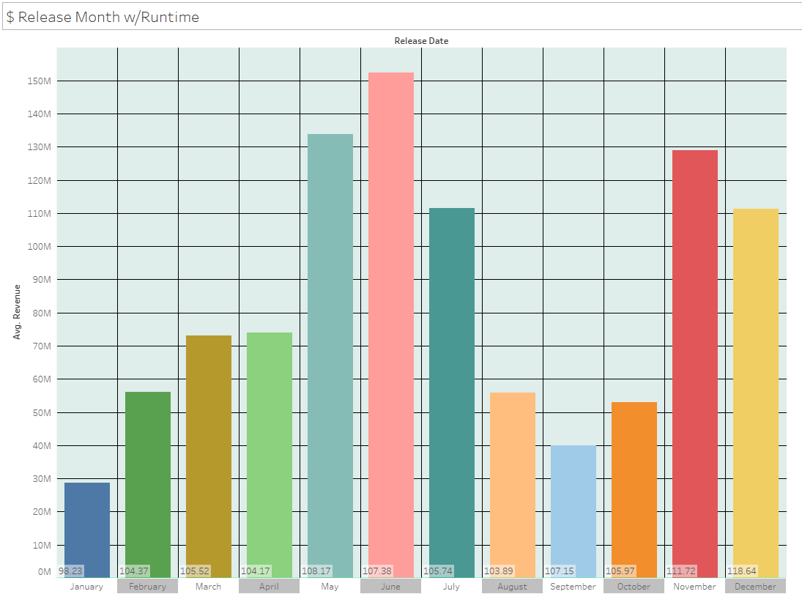
Release Month w/Runtime

Slide 8

Supervised Learning Models
Decision Tree
Random Forest
K-nearest Neighbors
Support Vector Machine (SVM)

Slide 9
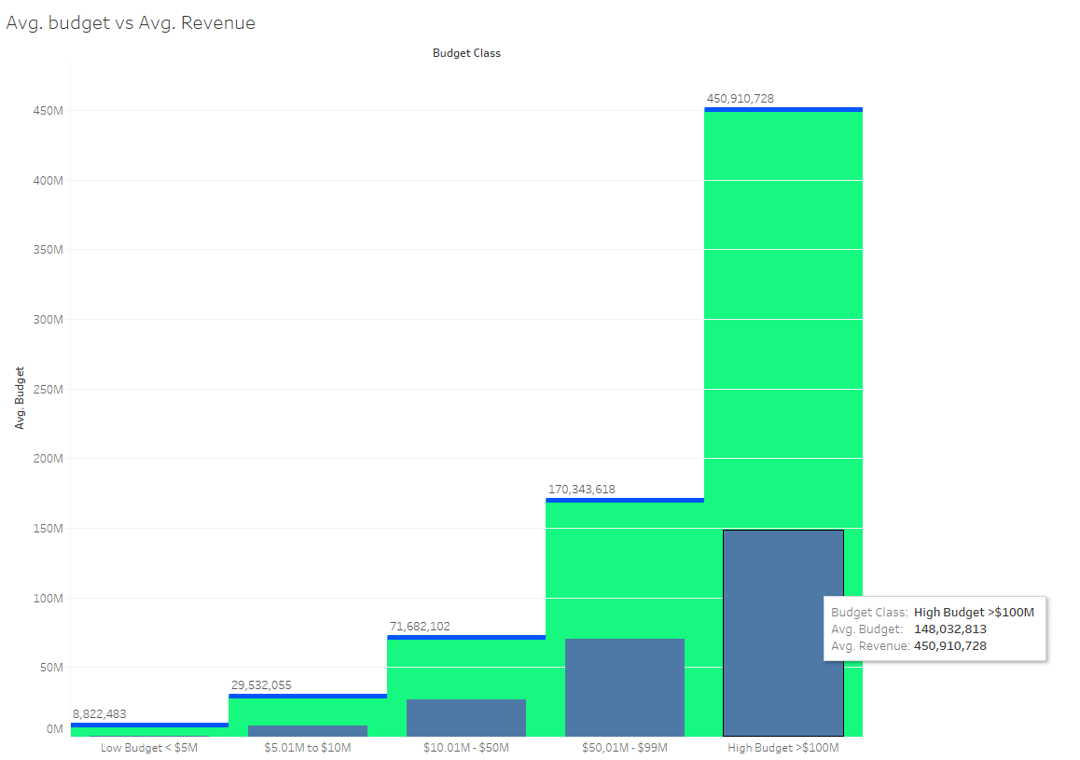
Average Budget vs. Average Revenue

Slide 10
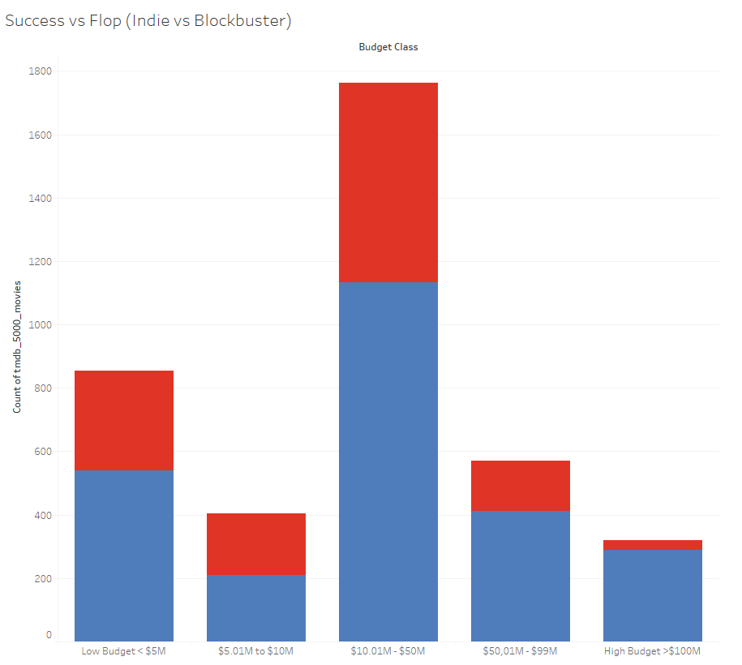
Success vs. Flop

Slide 11

Success Criteria
'Popularity Success’: Movie successful if a movie's popularity feature is greater than the mean of all popularity scores.
'Vote Success': likewise, if the voting_average of a movie is higher than the mean of all vote averages it is successful.
'Commercial Success': if a movie's gross profit exceeds its budget then it is successful.

Slide 12
Supervised Learning Models
Decision Tree
Random Forest
K-nearest Neighbors
Support Vector Machine (SVM)

Slide 13
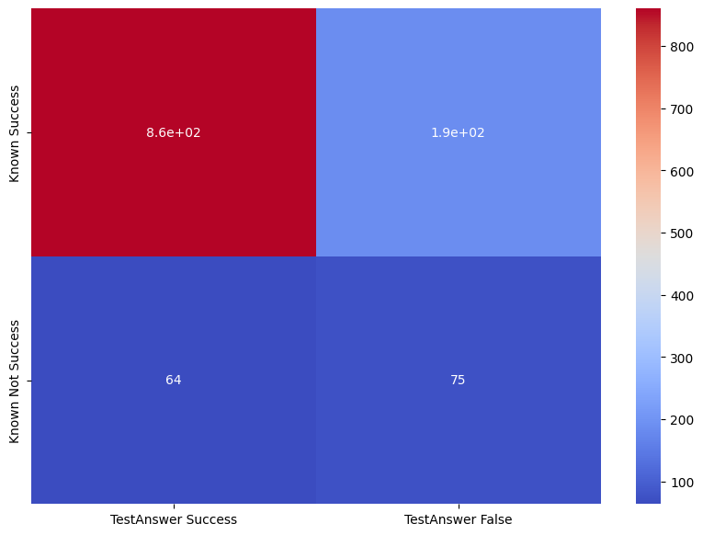
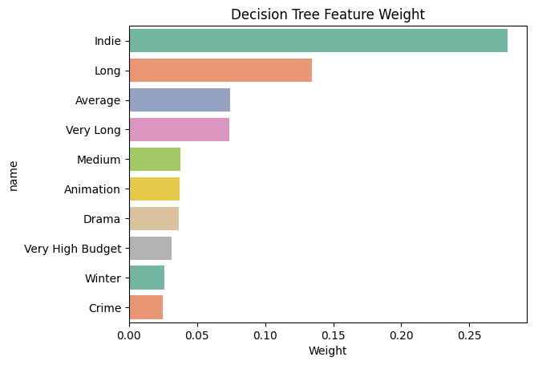
Decision Tree
To train our models, we split our data randomly so that 75% is used as training and 25% as predictions.
Cross-validation accuracy: 77%
Overall accuracy: 79%

Slide 14
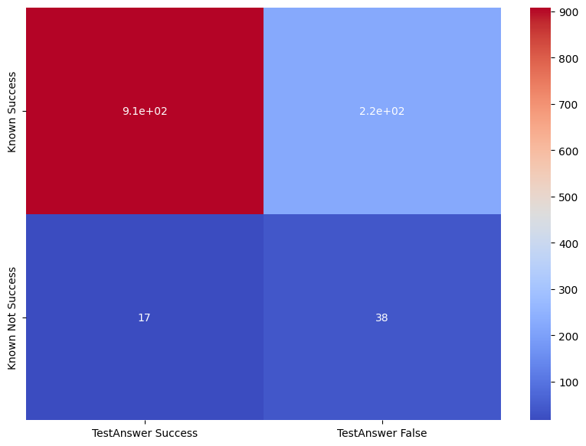
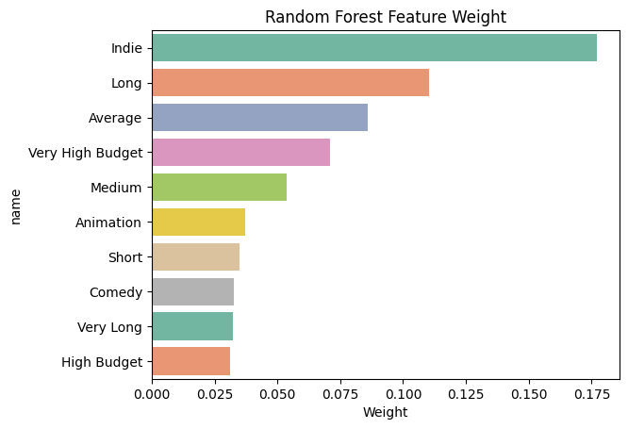
Random Forest Results
Cross-validation accuracy: 76%
Overall accuracy: 79%

Slide 15
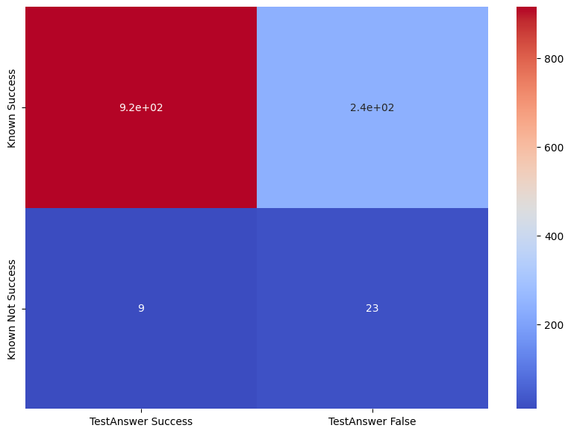
K-Nearest Neighbors
Cross-validation accuracy: 79%
Overall accuracy: 79%

Slide 16

Support Vector Machine Model
Cross-validation accuracy: 76%
Overall accuracy: 79%

